Slide 1
phonegap

Slide 2
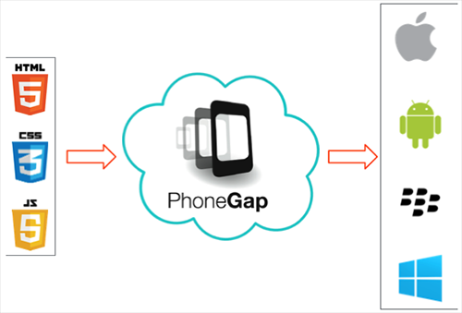
PhoneGap is a software development framework by Adobe System, which is used to develop mobile applications. To develop apps using PhoneGap, the developer does not require to have knowledge of mobile programming language but only web-development languages like, HTML, CSS, and JScript.

Slide 3
Prerequisites
It is mandatory that you have knowledge of HTML, CSS and JScript to create website that you might want to put on App. No other programming language is required to use PhoneGap.

Slide 4
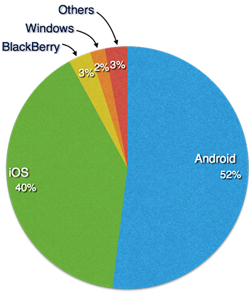
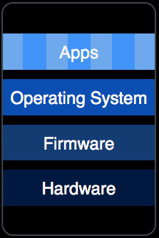
The architecture of a mobile device is similar to that of a computer system. It has custom built hardware, firmware, and operating systems.

Slide 5
From a developer’s perspective, an app should have the following items included in its package −
Configuration files(config.xml)
Icons for app
Information or content (built using web technologies)

Slide 6
Configuration
<?xml version = "1.0" encoding = "UTF-8"?>
<widget xmlns="http://www.w3.org/ns/widgets" xmlns:gap="http://phonegap.com/ns/1.0" id="com.tutorialspoint.onlineviewer" version="1.0">
<name>Tutorials Point</name>
<description>
Tutorials Point Online Viewer
</description>
<author href="http://tutorialspoint.com" email="contact@tutorialspoint.com">
Tutorials Point
</author>
<preference name="permissions" value="none" />
<icon src="res/icon/android/drawable-ldpi/tp_icon.png" gap:platform="android" gap:qualifier="ldpi" />
<icon src="res/icon/android/drawable-mdpi/tp_icon.png" gap:platform="android" gap:qualifier="mdpi" />
<icon src="res/icon/android/drawable-hdpi/tp_icon.png" gap:platform="android" gap:qualifier="hdpi" />
<icon src="res/icon/android/drawable-xhdpi/tp_icon.png" gap:platform="android" gap:qualifier="xhdpi" />
<icon src="res/icon/android/drawable-xxhdpi/tp_icon.png" gap:platform="android" gap:qualifier="xxhdpi" />
<icon src="res/icon/ios/Icon-72.png" gap:platform="ios" gap:qualifier="" />
<icon src="res/icon/ios/icon-57.png" gap:platform="ios" width="57" height="57" />
<icon src="res/icon/ios/icon-72.png" gap:platform="ios" width="72" height="72" />
<icon src="res/icon/ios/icon-57-2x.png" gap:platform="ios" width="114" height="114" />
<icon src="res/icon/ios/icon-72-2x.png" gap:platform="ios" width="144" height="144" />
</widget>

Slide 7
Configuration
<?xml version = "1.0" encoding = "UTF-8"?>
<widget xmlns="http://www.w3.org/ns/widgets" xmlns:gap="http://phonegap.com/ns/1.0" id="com.tutorialspoint.onlineviewer" version="1.0">
<name>Tutorials Point</name>
<description>
Tutorials Point Online Viewer
</description>
<author href="http://tutorialspoint.com" email="contact@tutorialspoint.com">
Tutorials Point
</author>
<preference name="permissions" value="none" />
<icon src="res/icon/android/drawable-ldpi/tp_icon.png" gap:platform="android" gap:qualifier="ldpi" />
<icon src="res/icon/android/drawable-mdpi/tp_icon.png" gap:platform="android" gap:qualifier="mdpi" />
<icon src="res/icon/android/drawable-hdpi/tp_icon.png" gap:platform="android" gap:qualifier="hdpi" />
<icon src="res/icon/android/drawable-xhdpi/tp_icon.png" gap:platform="android" gap:qualifier="xhdpi" />
<icon src="res/icon/android/drawable-xxhdpi/tp_icon.png" gap:platform="android" gap:qualifier="xxhdpi" />
<icon src="res/icon/ios/Icon-72.png" gap:platform="ios" gap:qualifier="" />
<icon src="res/icon/ios/icon-57.png" gap:platform="ios" width="57" height="57" />
<icon src="res/icon/ios/icon-72.png" gap:platform="ios" width="72" height="72" />
<icon src="res/icon/ios/icon-57-2x.png" gap:platform="ios" width="114" height="114" />
<icon src="res/icon/ios/icon-72-2x.png" gap:platform="ios" width="144" height="144" />
</widget>

Slide 8
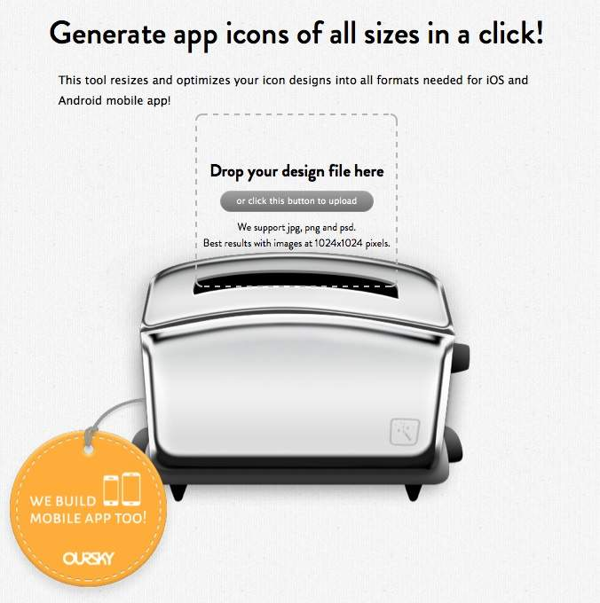
icon
<where to >

Slide 9
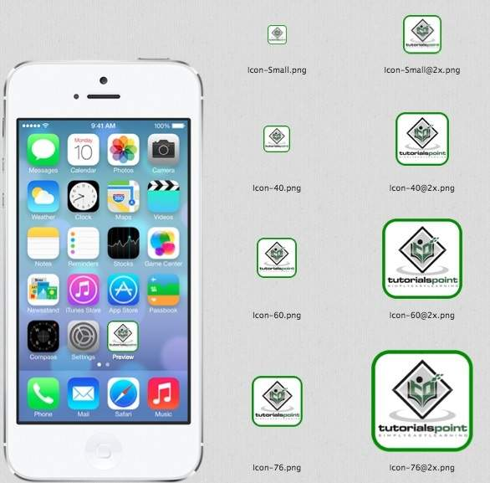

Slide 10
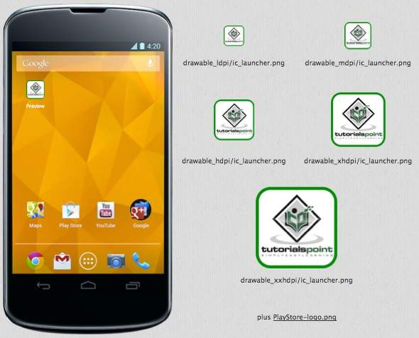

Slide 11
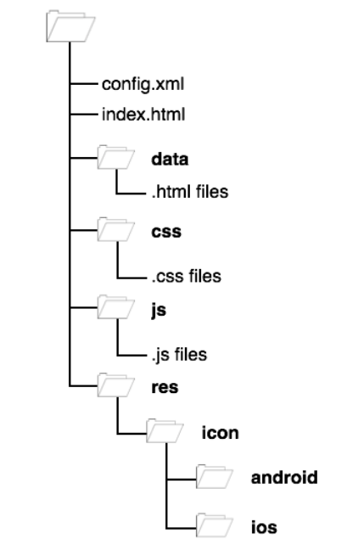
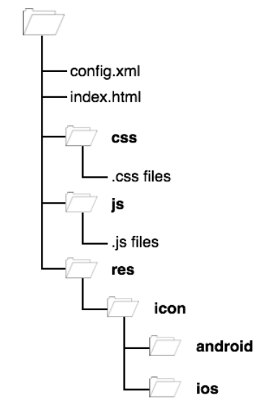
App content
offline app
online app

Slide 12
apk 打包提要

Slide 13
在chrome上，測試要封裝成android app的程式碼: html+ccs+javaScript

Slide 14
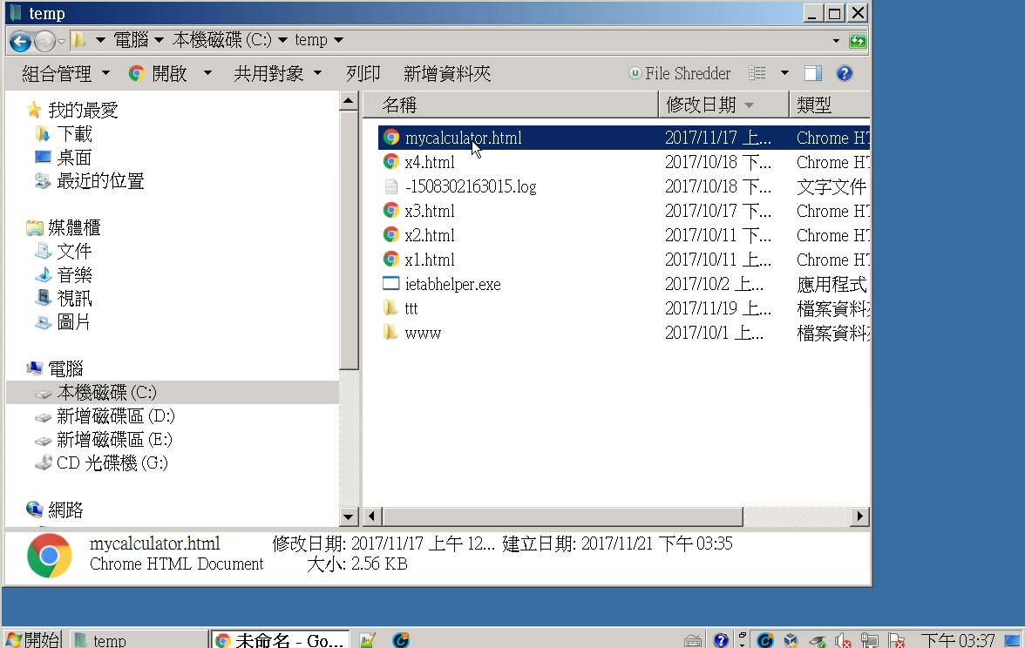

Slide 15
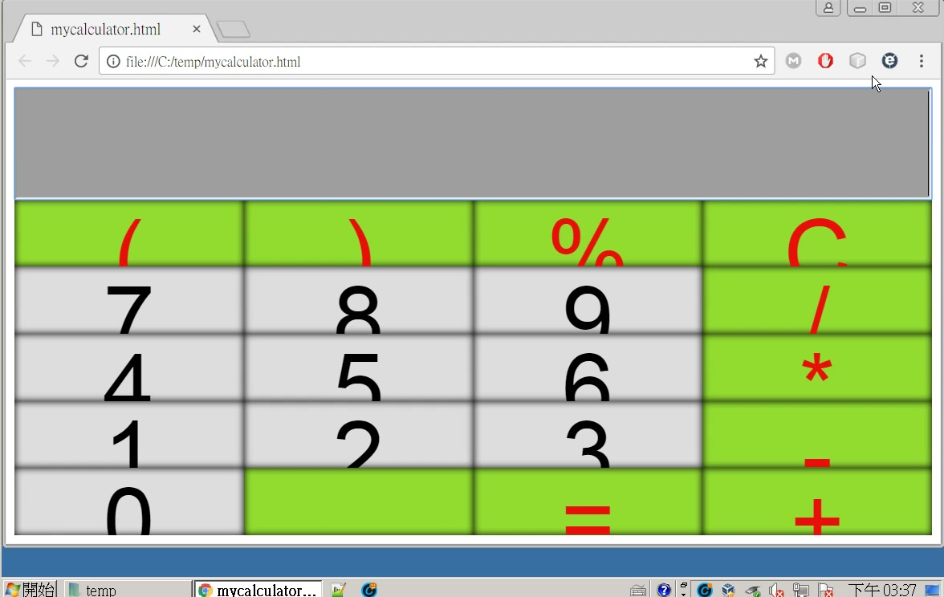
先在crhome 上測試，直到滿意為止

Slide 16
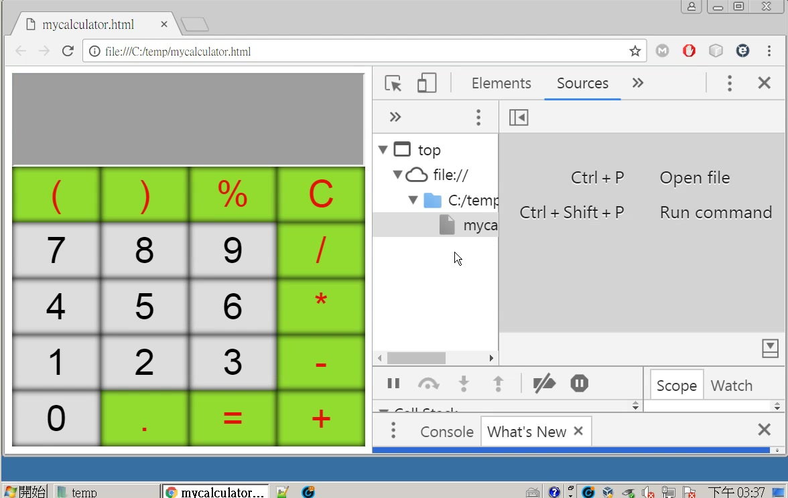

Slide 17
準備要封裝成android app的程式碼

Slide 18
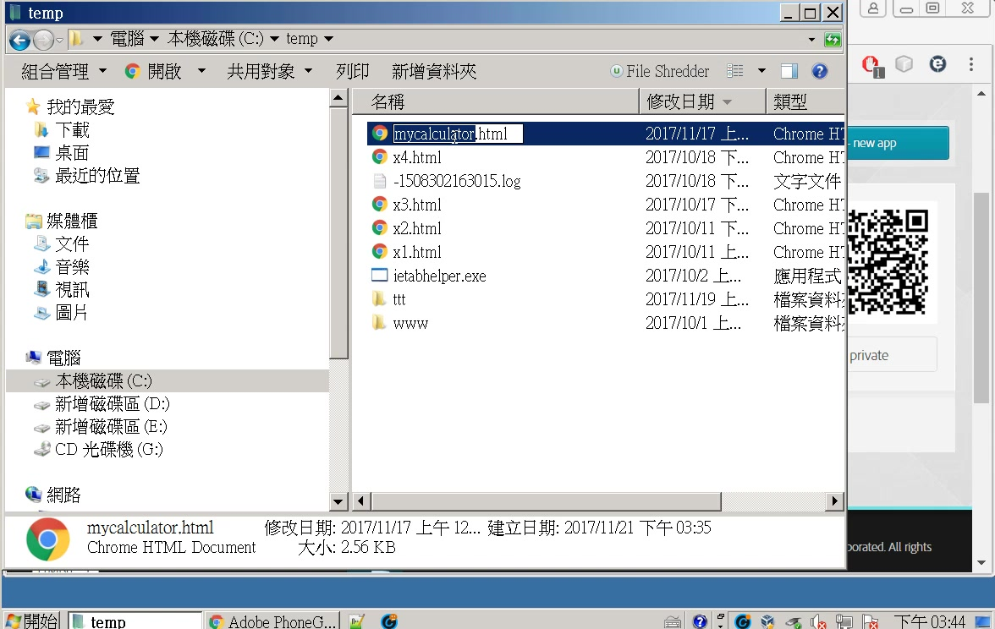

Slide 19
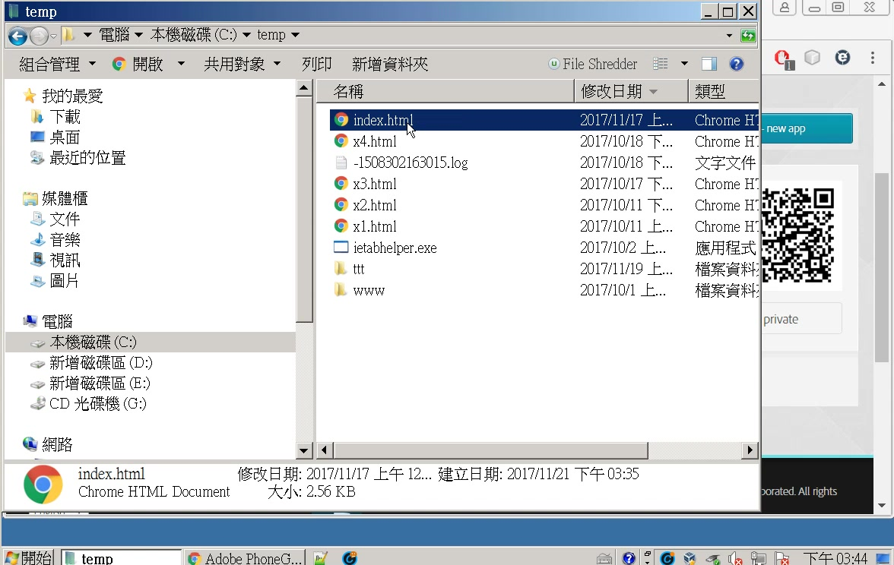

Slide 20
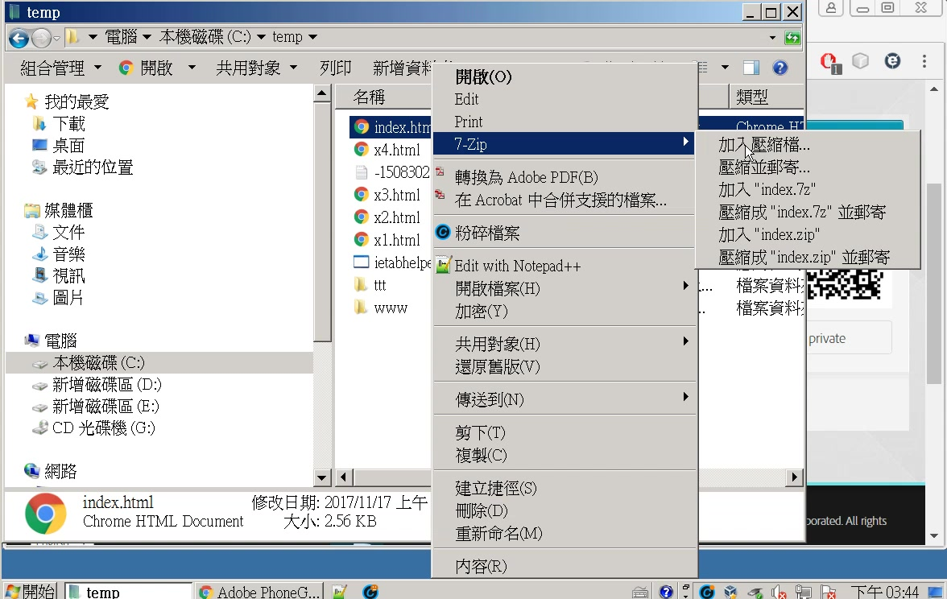

Slide 21
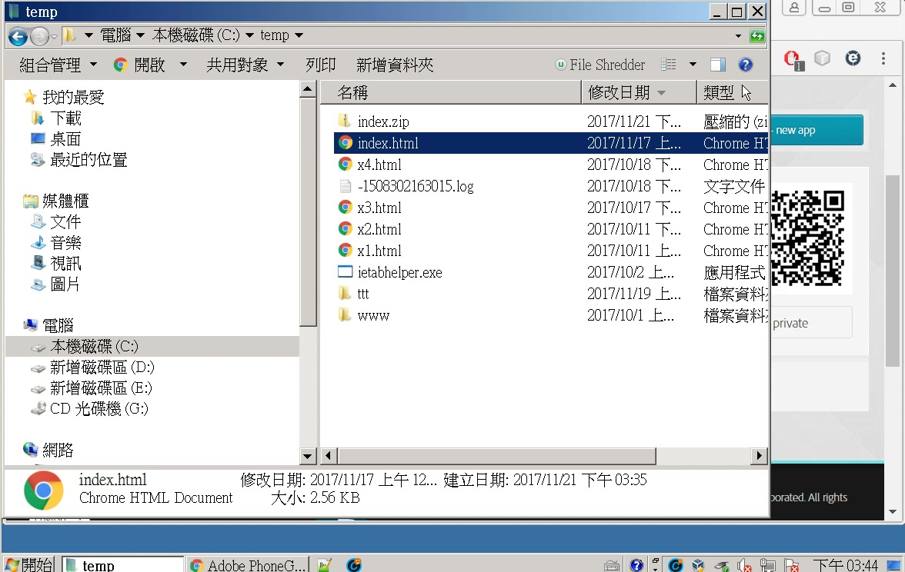

Slide 22
新增adobe id

Slide 23
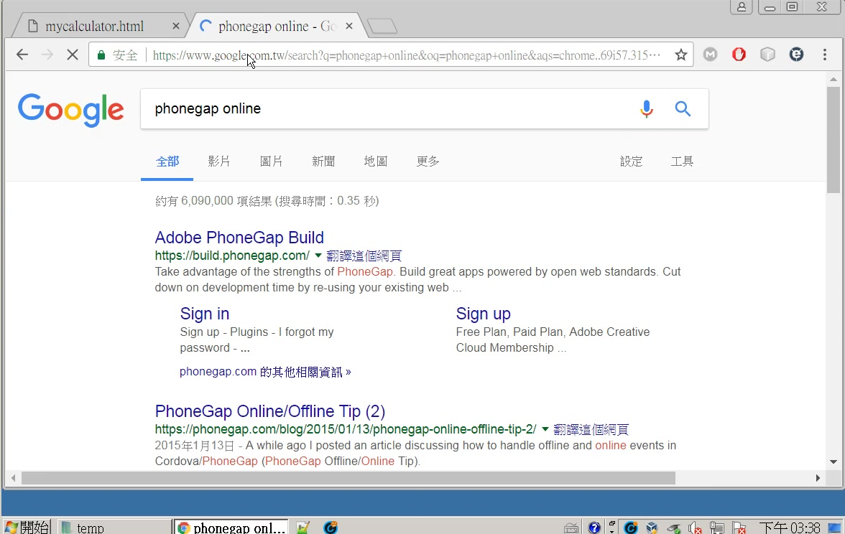

Slide 24
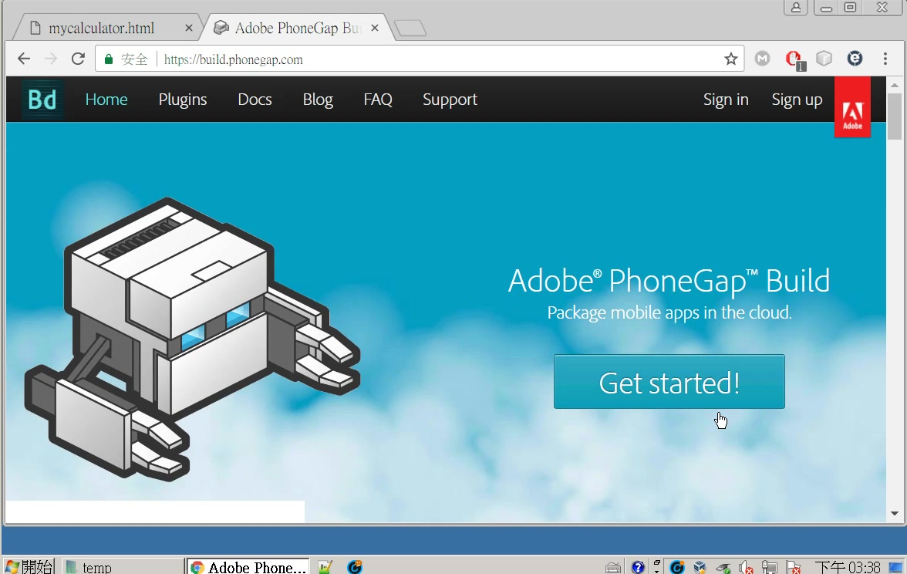

Slide 25
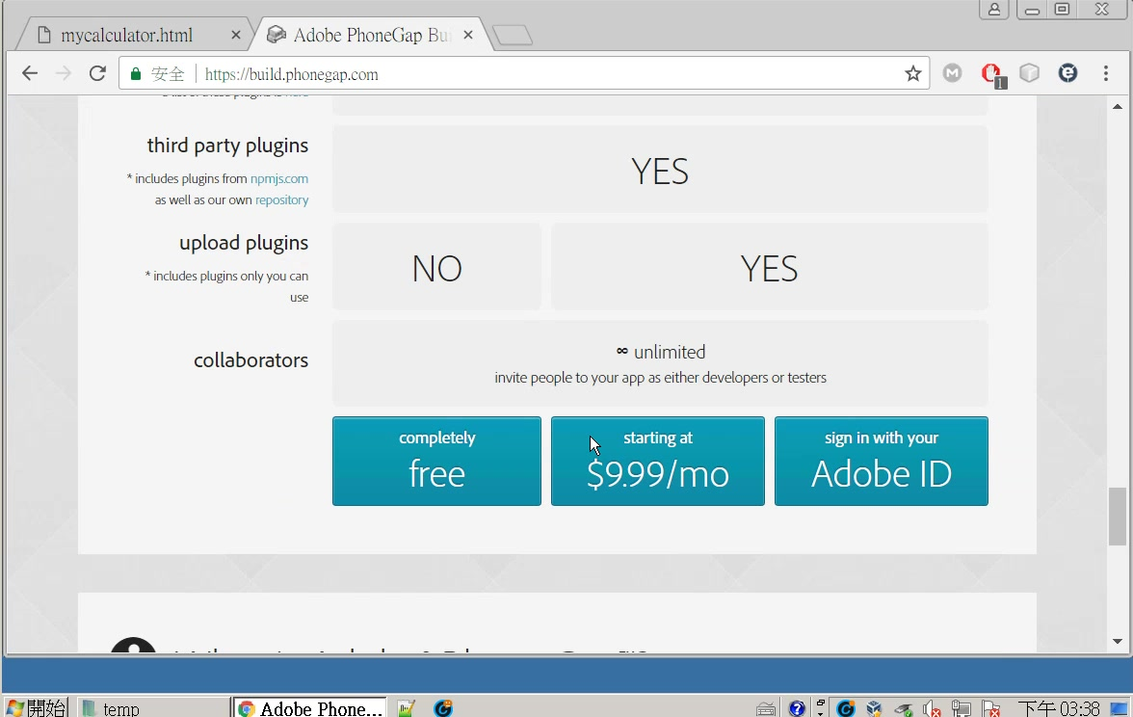

Slide 26
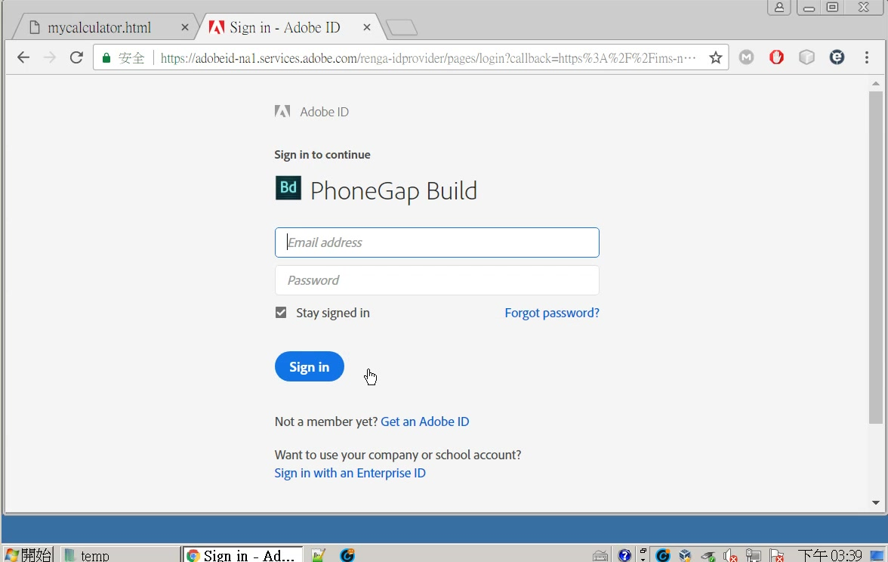

Slide 27
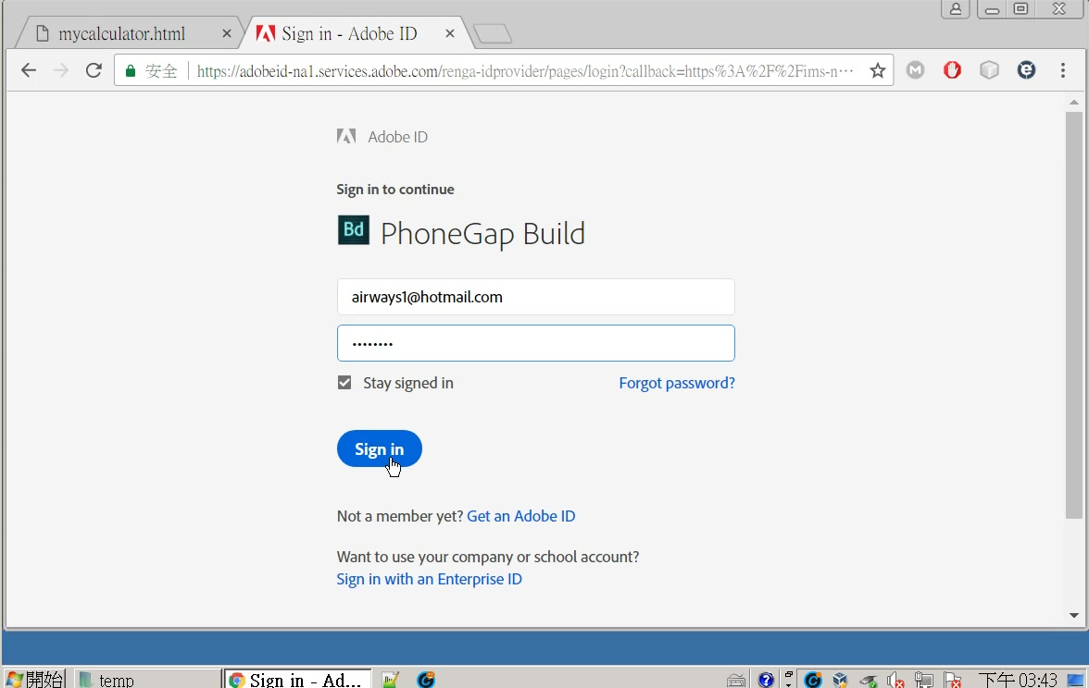
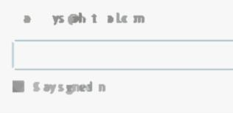

Slide 28
第一次在phonegap online建立app

Slide 29
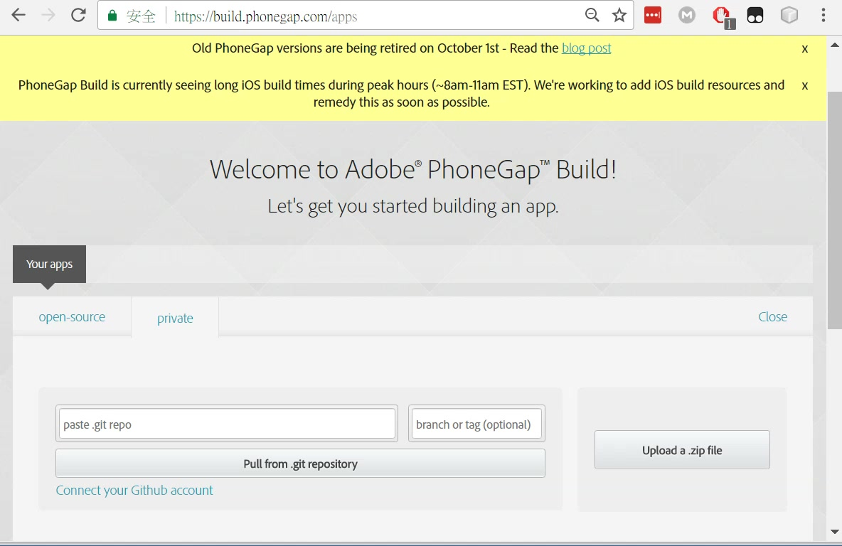

Slide 30
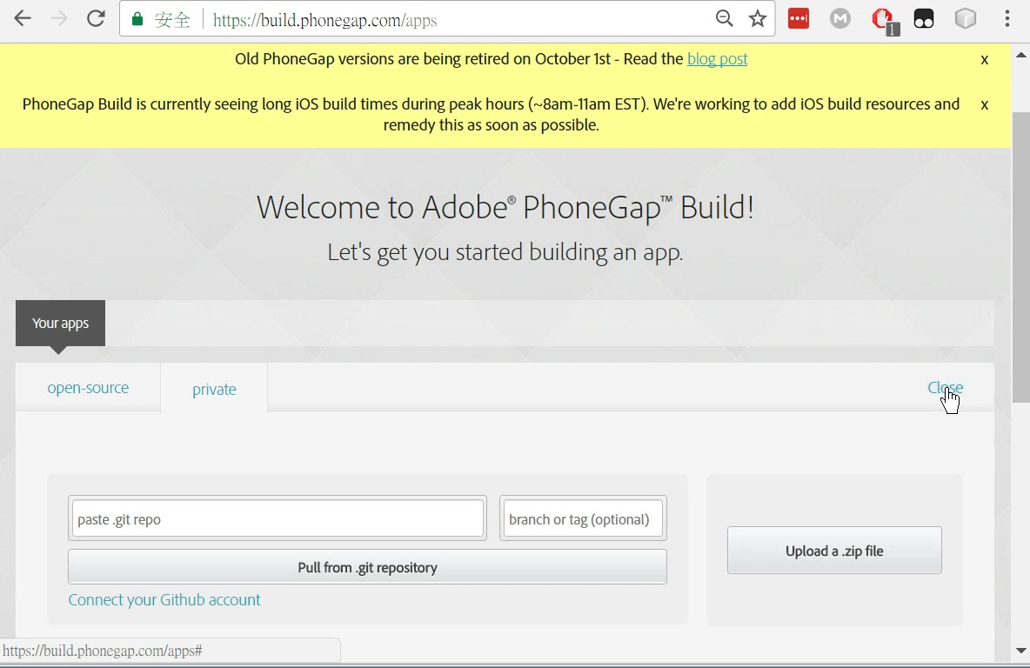
如果不選上面的
upload a .zipi file
也可以直接關閉

Slide 31
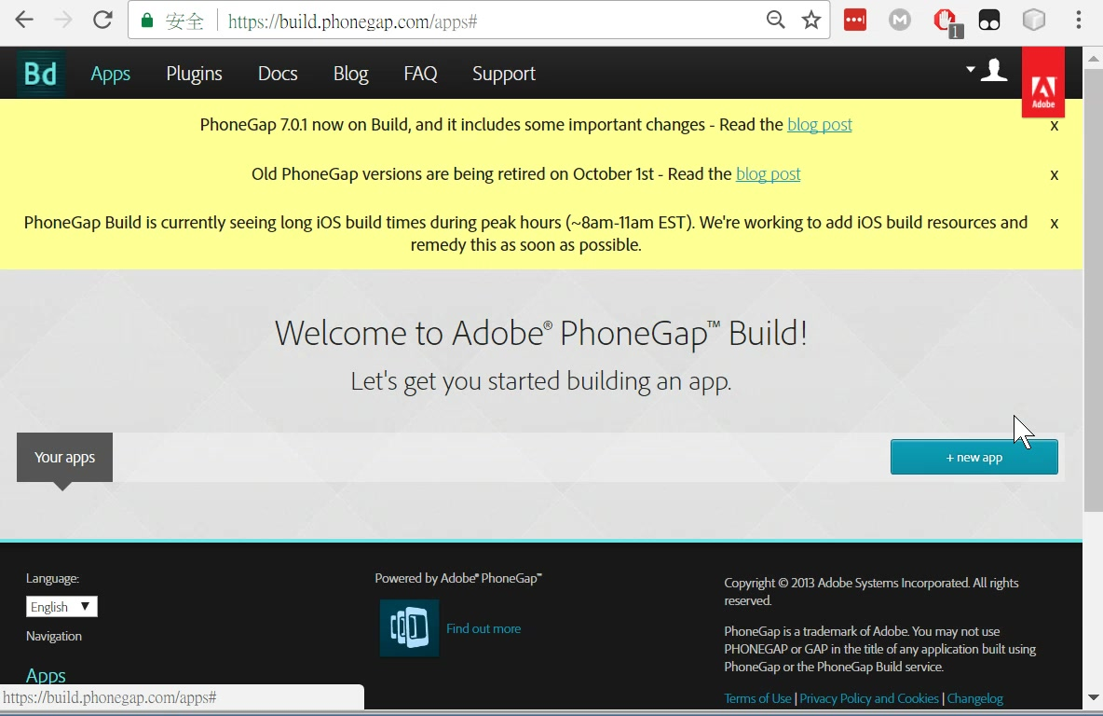
如果選了close

Slide 32
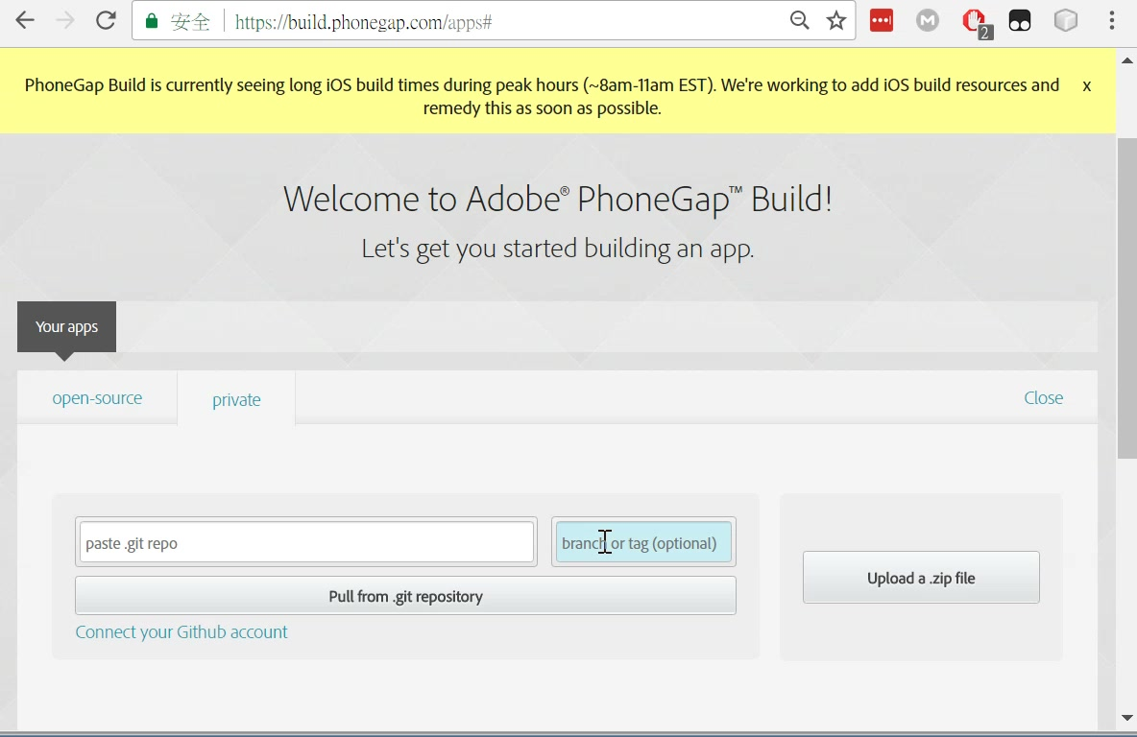
還是回到這裡

Slide 33
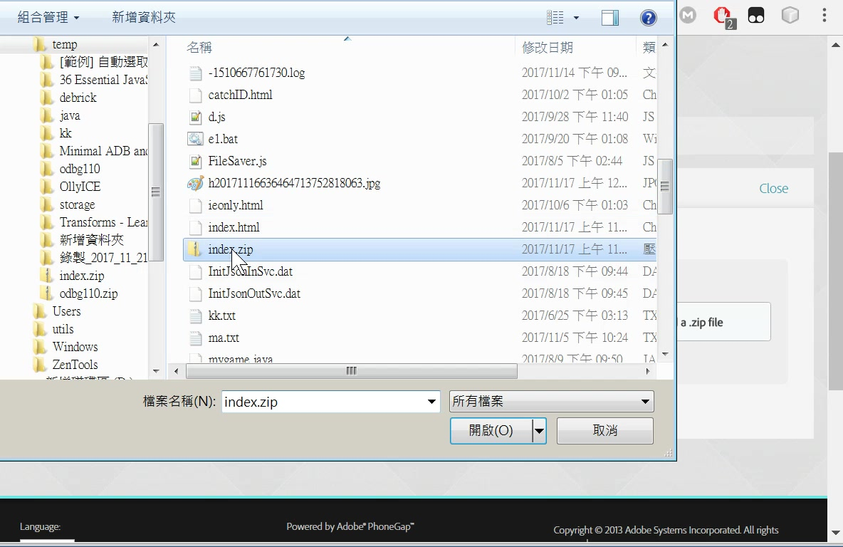

Slide 34
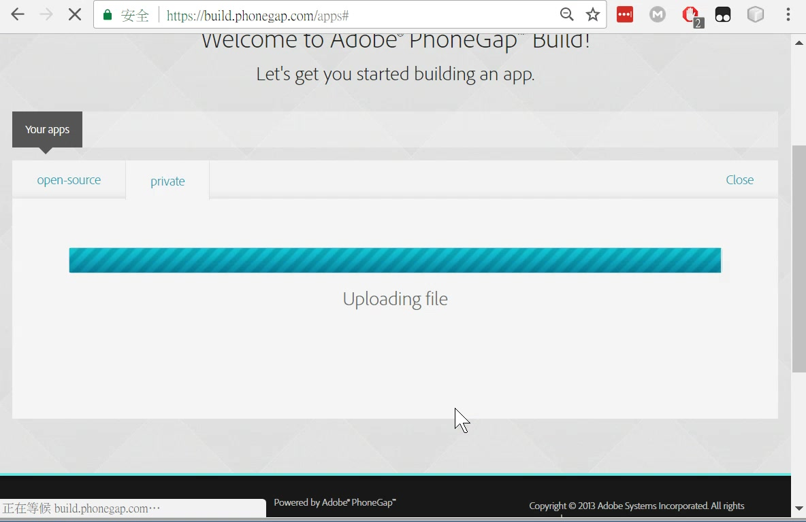

Slide 35
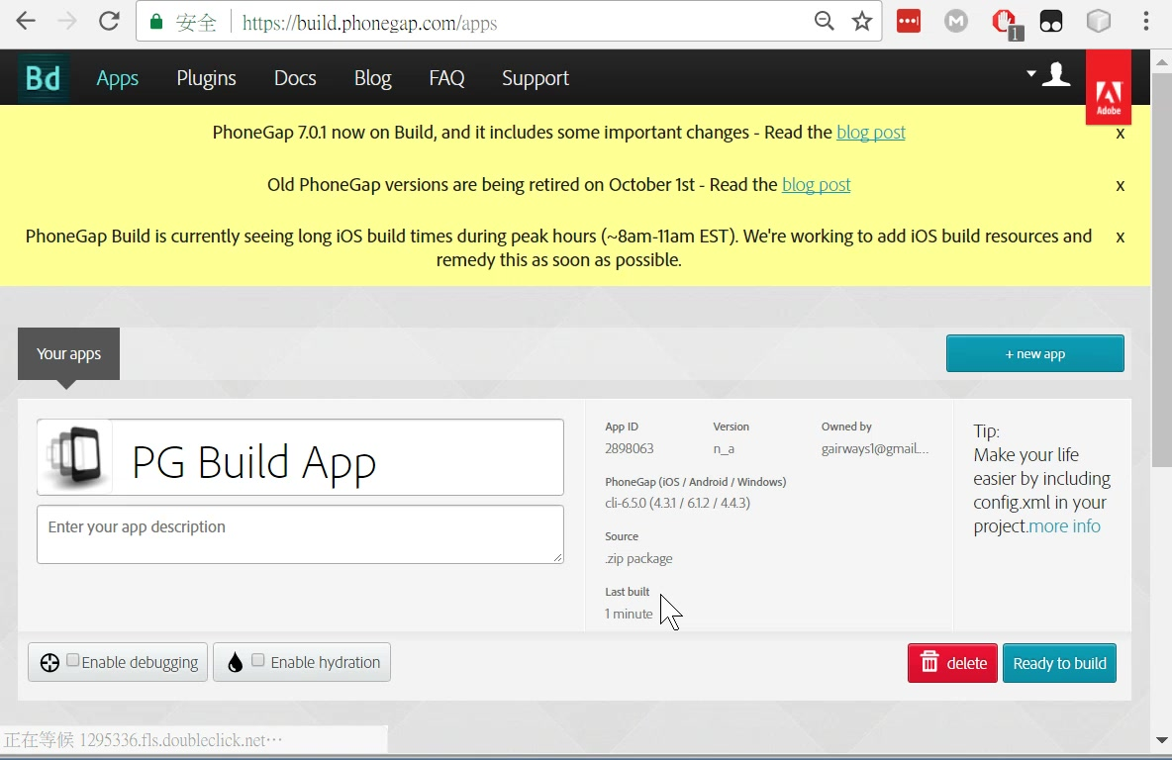
1
2

Slide 36
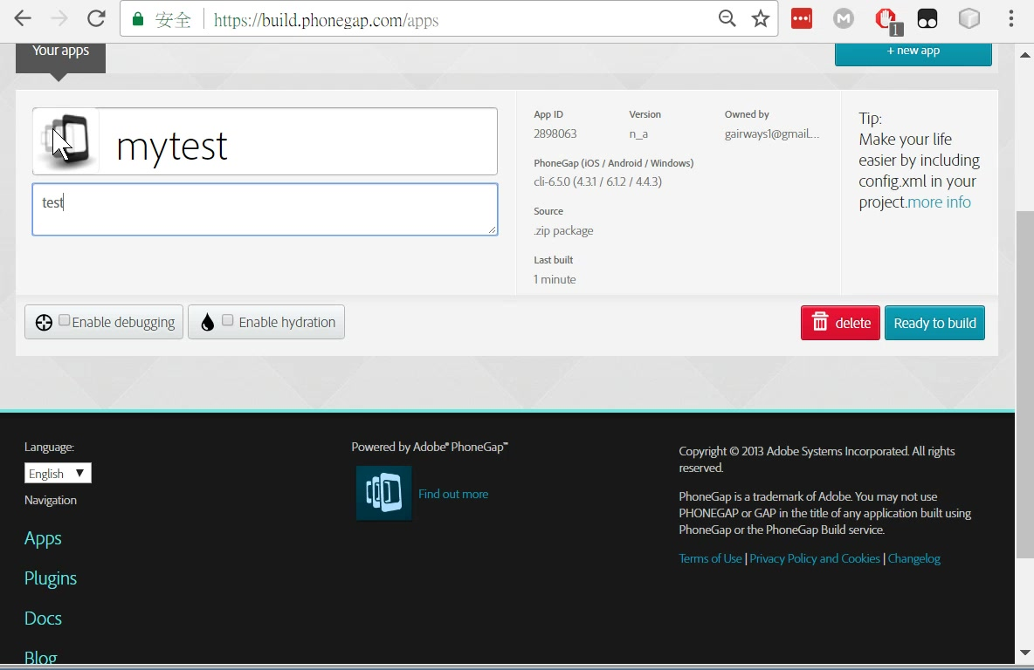
optional

Slide 37
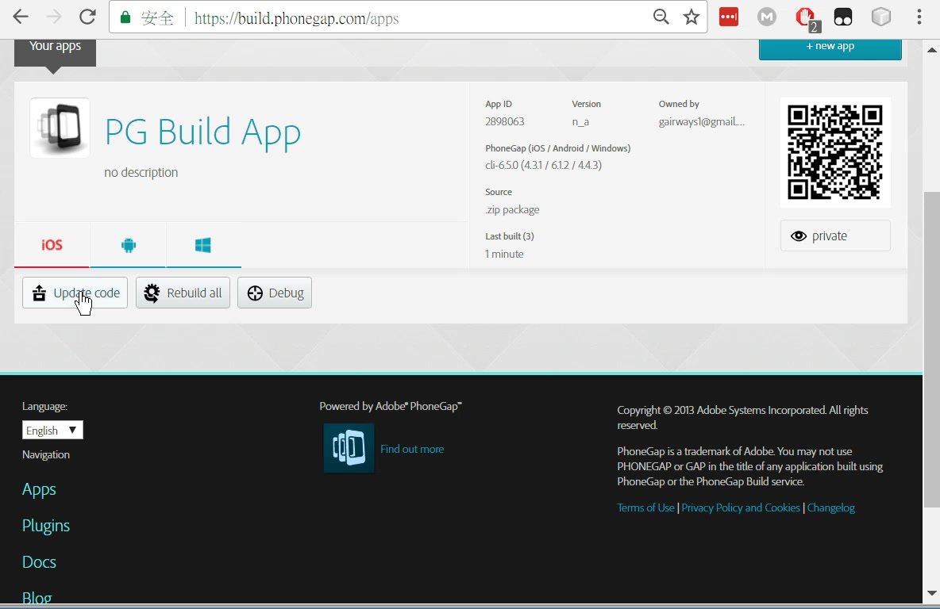
再一次（bug?)

Slide 38
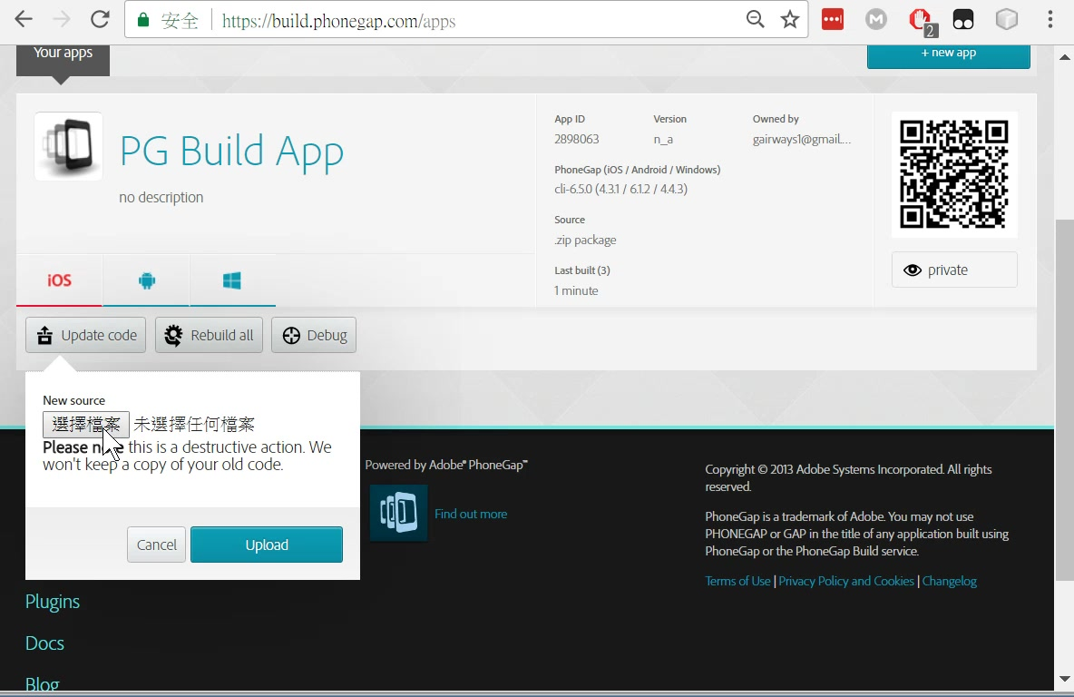

Slide 39
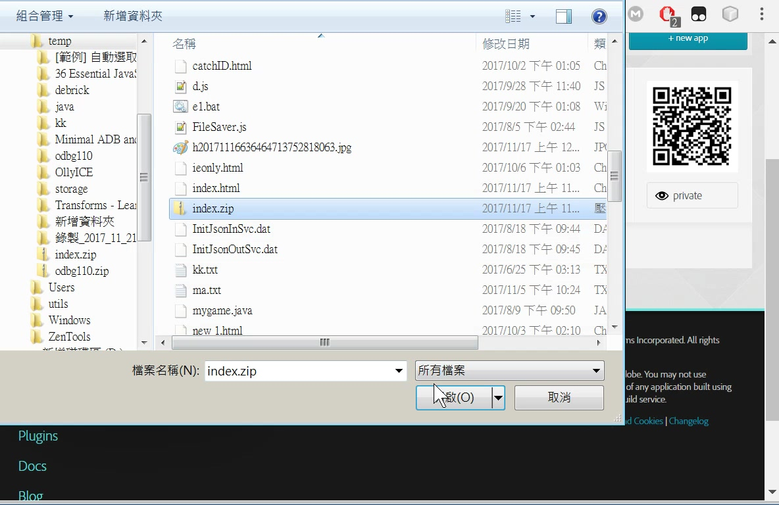

Slide 40
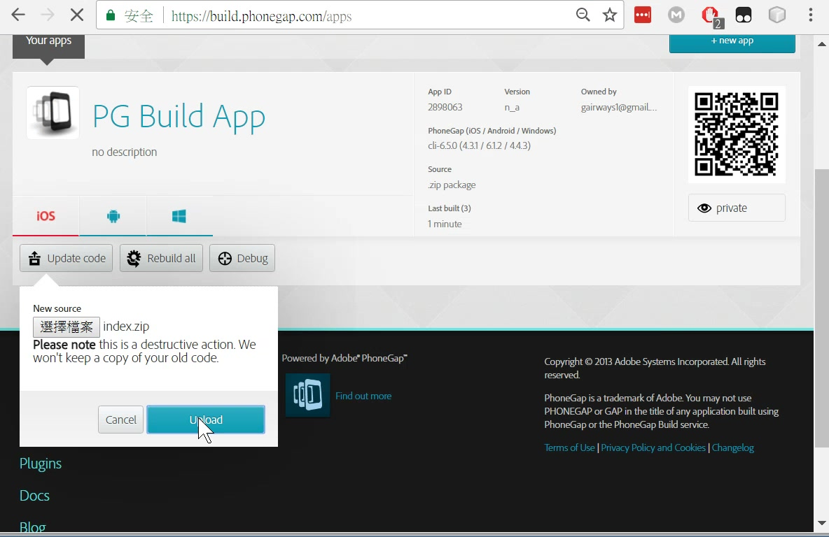

Slide 41
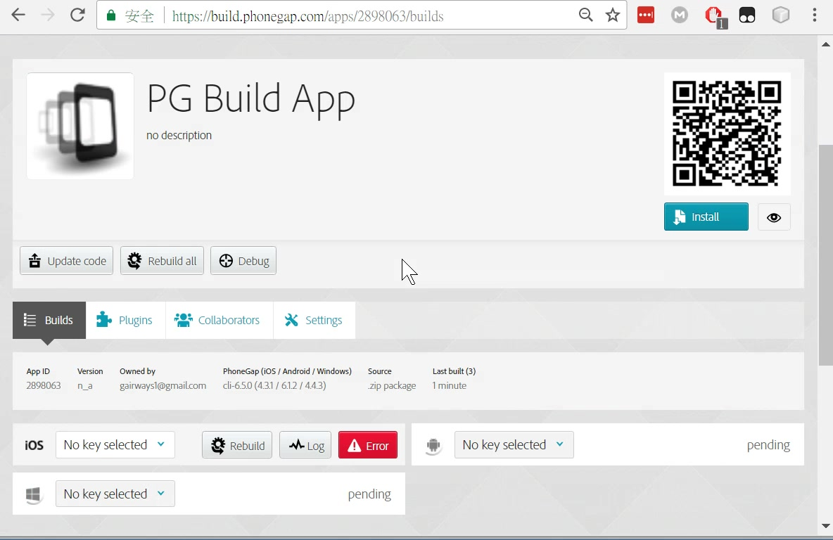

Slide 42
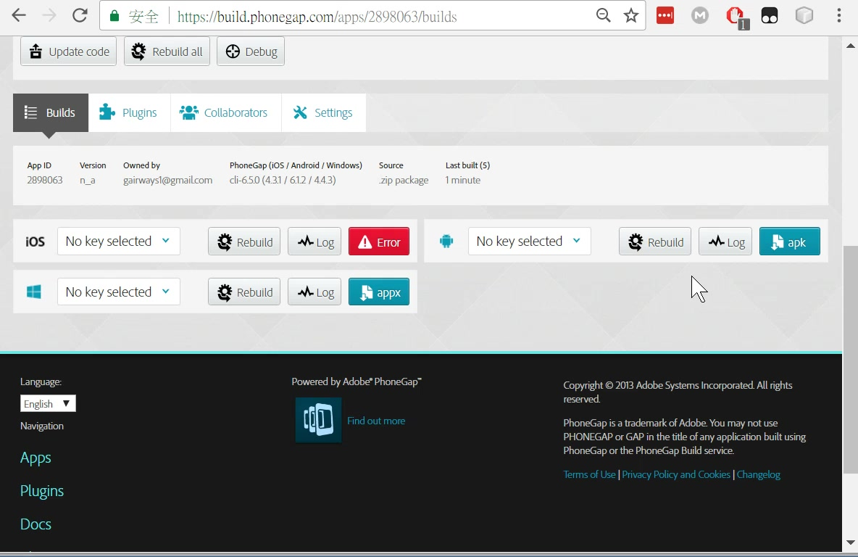
想辦法下載到手機

Slide 43
更新程式碼或是另外測試其他程式碼

Slide 44
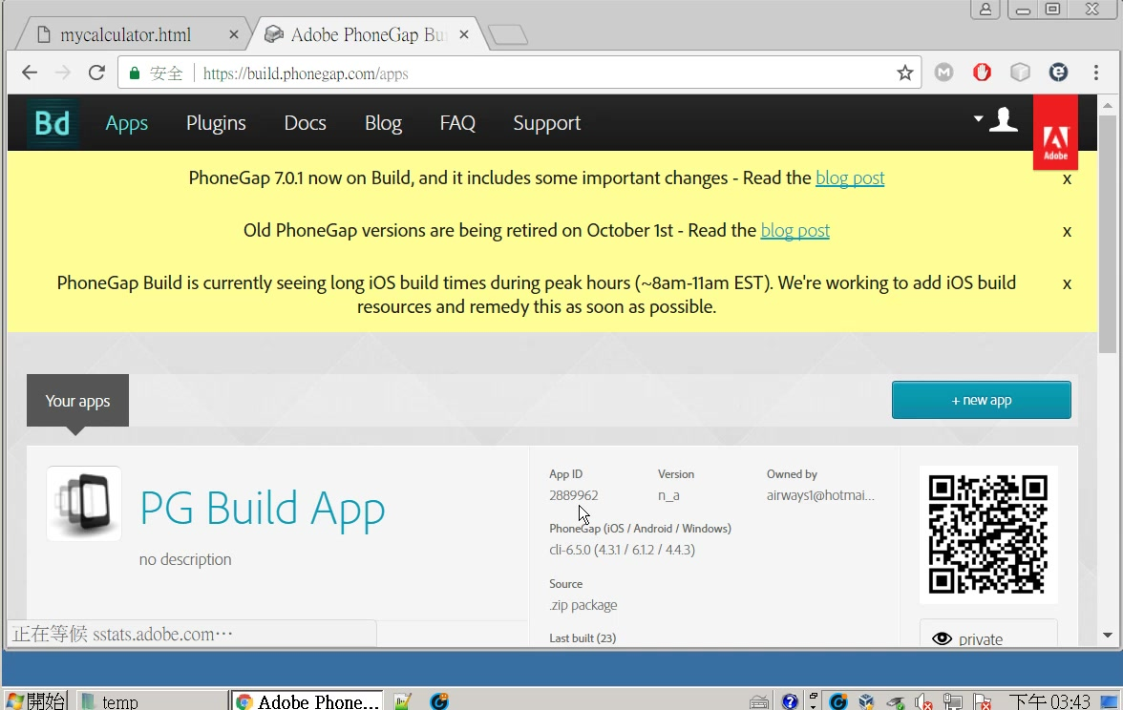

Slide 45
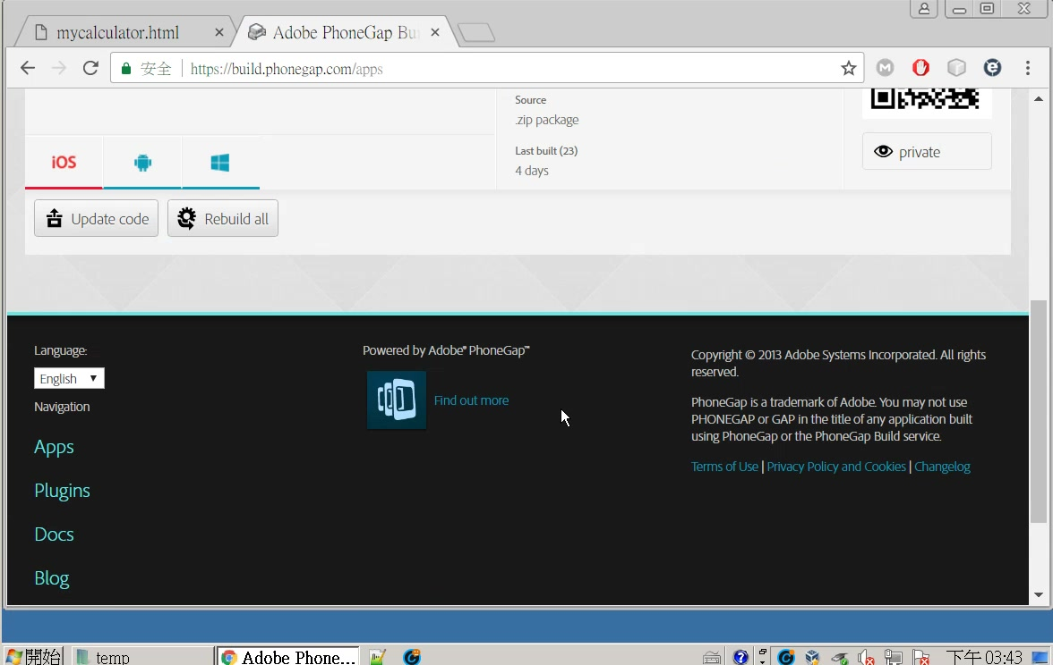

Slide 46
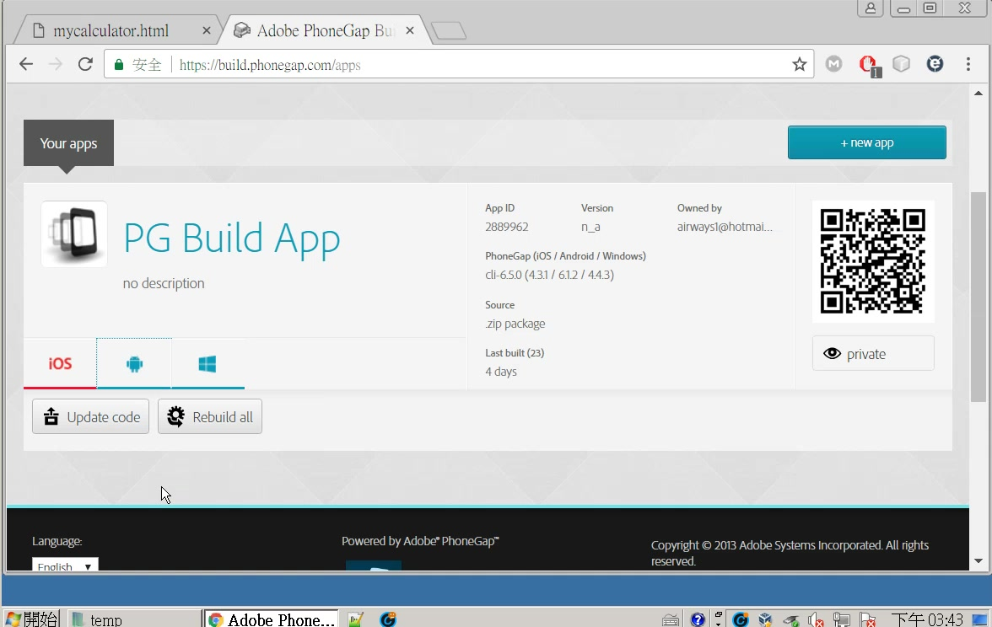

Slide 47
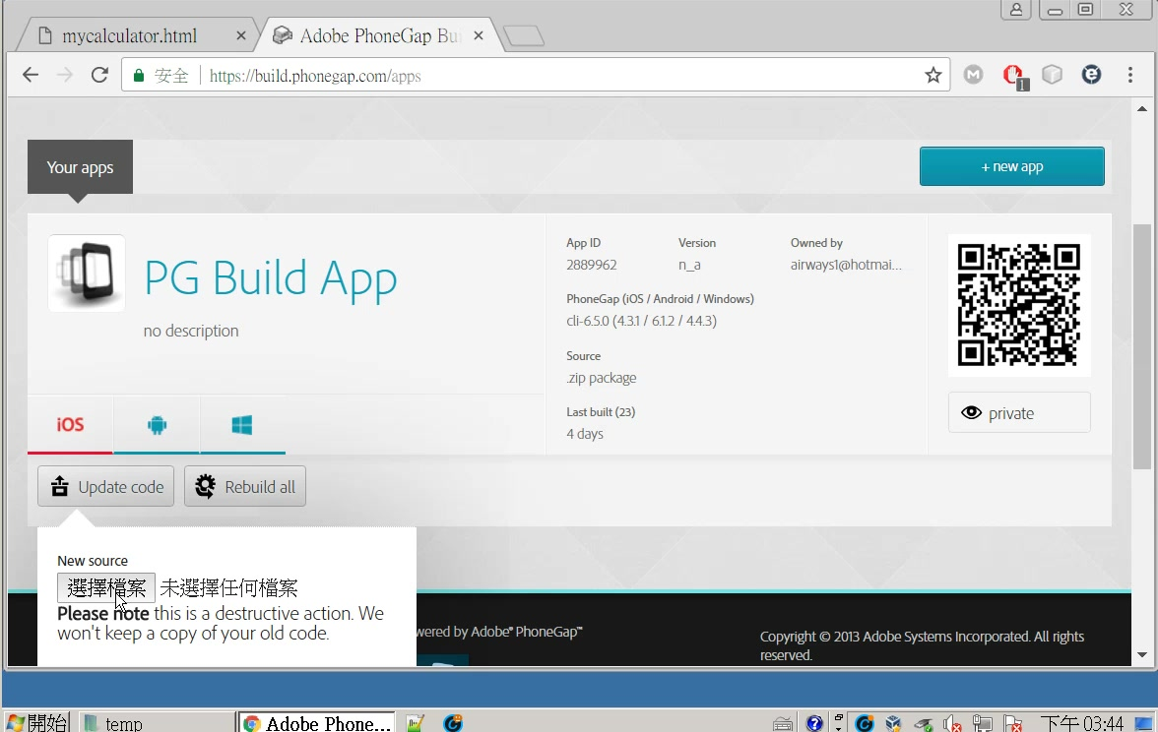
1
2

Slide 48
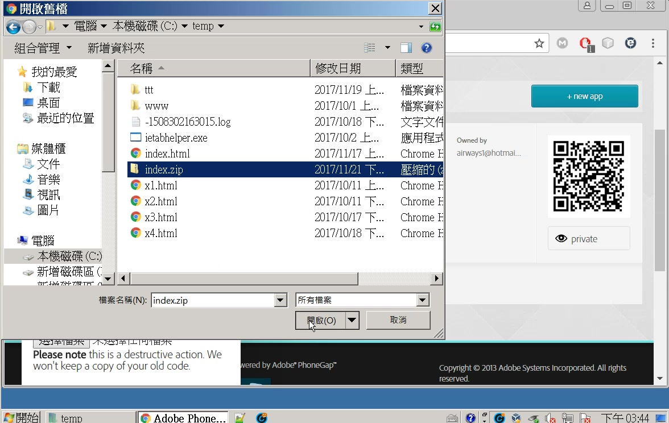

Slide 49
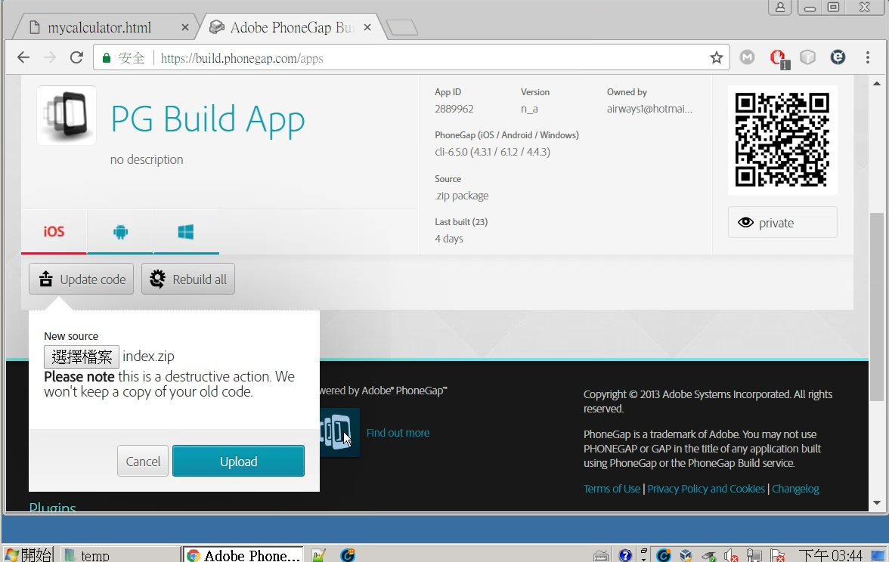

Slide 50
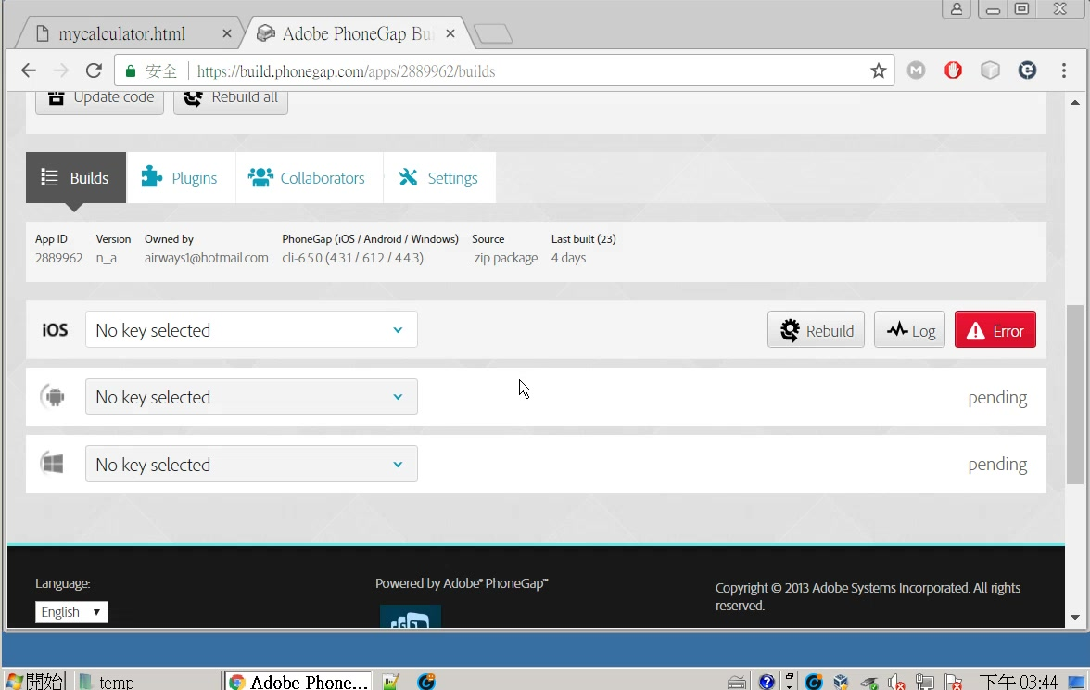

Slide 51
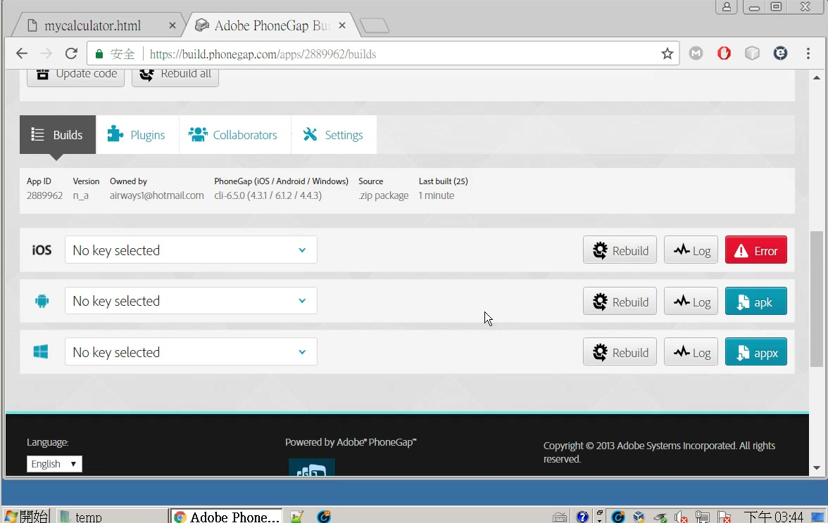

Slide 52
利用qr scanner 連上apk網址
QR Code 掃描器

Slide 53
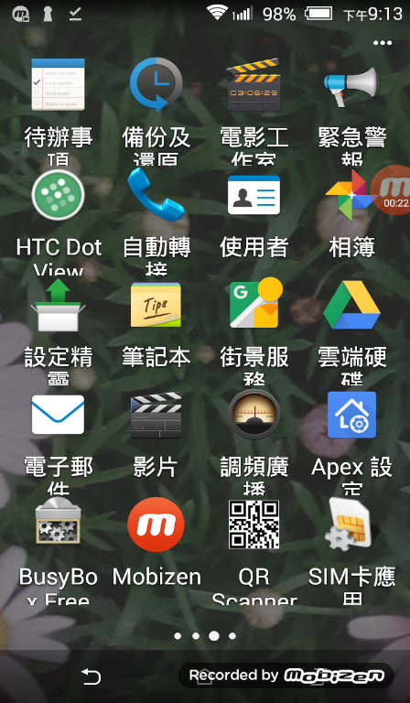
QR Scanner

Slide 54
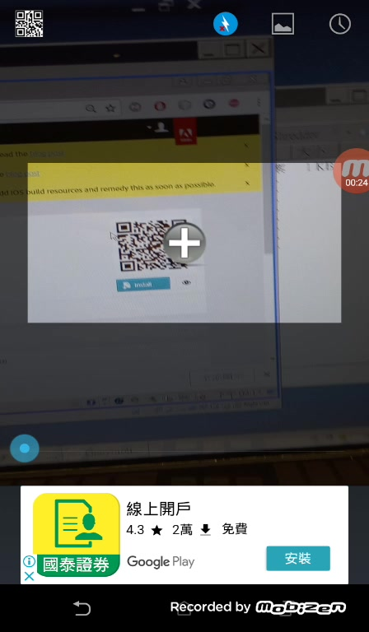

Slide 55
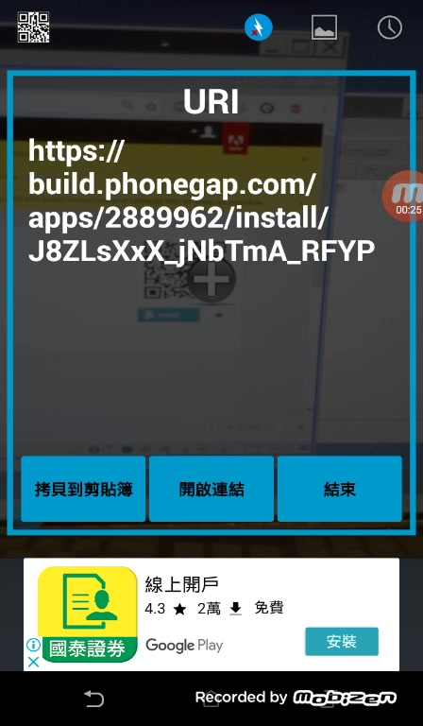

Slide 56
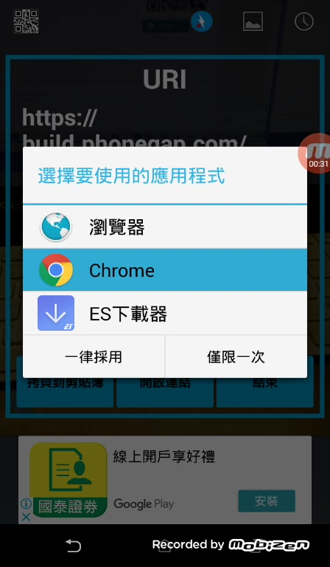

Slide 57
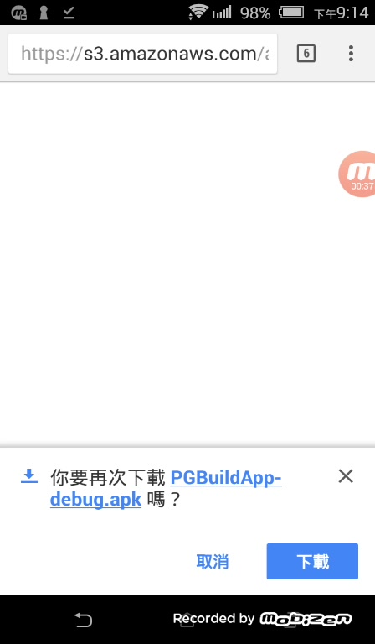

Slide 58
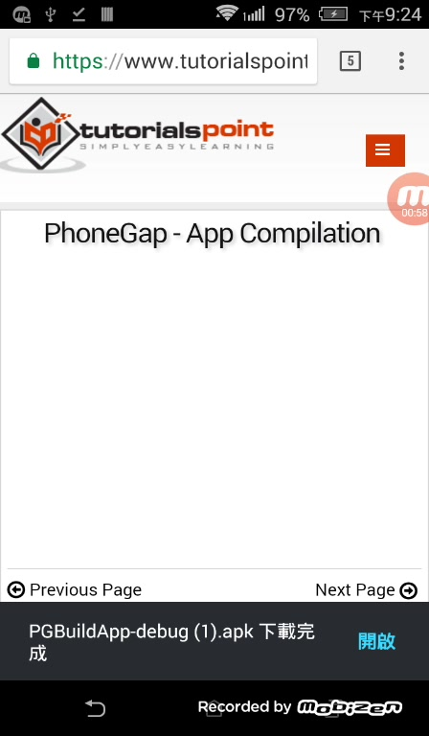

Slide 59
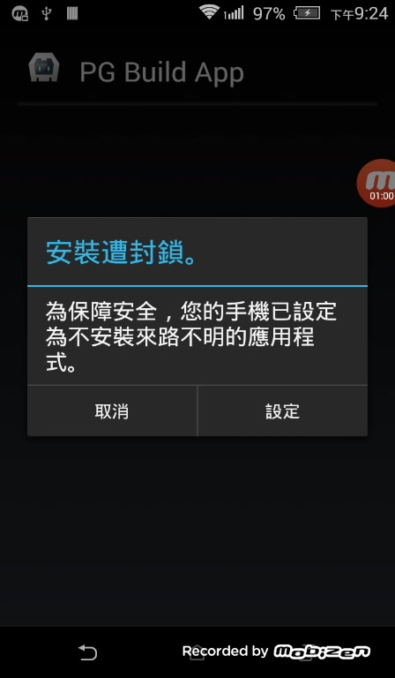

Slide 60


Slide 61


Slide 62


Slide 63


Slide 64


Slide 65


Slide 66


Slide 67


Slide 68


Slide 69
利用android emulator 測試

Slide 70

1
2

Slide 71

drag drop to Genymotion

Slide 72


Slide 73


Slide 74


Slide 75


Slide 76


Slide 77


Slide 78
draw in photo

Slide 79


Slide 80


Slide 81


Slide 82

draw on photo
無法在htc 上執行？
phonegap on htc?

Slide 83
附錄
安全性設定

Slide 84


Slide 85


